Slide 1
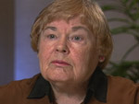

Dorothea Orem
Jen Skripka
Rene Ames
Kelly Geraghty
Susan Devereaux

Slide 2

Historical Evolution
Honorary Doctorates received:
  1976-Doctor of Science from Georgetown University
  1980-Doctor of Science from Incarnate Word College, San Antonio, Texas
  1988-Doctor of Humane Letters from Illinois Wesleyan University, Bloomington, Illinois
Awards:
  1980-Catholic University of America Alumni Achievement Award for Nursing Theory (Hartweg, 1991, p.1)

Slide 3

Historical Evolution
Early experiences include:
  Operating room nursing
  Private duty nursing in the home and the hospital
  Staff nursing on medical-surgical units, pediatric and adult
  Emergency room evening supervisor
  Biological science teacher (Alligood, 2010, p. 264)

Slide 4
Historical Evolution
1940 to 1949- Held the directorship of the nursing school and the Department of Nursing at Providence Hospital in Detroit
1949 to 1957- Developed the definition of nursing practice while she worked at the Division of Hospital and Institutional Services of the Indiana State Board of Health (Alligood, 2010, p. 265).
  “Her goal while she was there was to upgrade the quality of nursing in general hospitals throughout the state” (Alligood, p. 265).

Slide 5

Historical Evolution
1957-Worked in the Office of Education at the U.S. Department of Health, Education, and Welfare, as a curriculum consultant in Washington DC
1958 to 1960-Worked on a project to upgrade practical nurse training.
  It was during that time that she felt the need to answer a question: What is the subject matter of nursing? From that question, Guides for Developing Curricula for the Education of Practical Nurses, was developed (Alligood, 2010, p. 265).

Slide 6
Historical Evolution
1960-Assistant professor of nursing education and served as acting dean of the School of Nursing at CUA (Catholic University of America)
  It was here that she continued to develop her concepts of nursing and self-care (Alligood, 2010, p. 266)
1970- Orem left CUA to begin her own consulting firm and published her first book, Nursing: Concepts of Practice and was the editor for the NDCG (Nursing Development Conference Group) as they prepared Concept Formalization in Nursing: Process and Product
1984- Orem retired but continued to work on the development of the Self-Care Deficit Nursing Theory (Alligood, p. 266).

Slide 7
Self-Care Deficit Nursing Theory
“ Early on, Orem recognized that if nursing was to advance as a field of knowledge and as a field of practice, a structured, organized body of nursing knowledge was needed” (Alligood, 2010, p. 266).
Orem reflected on her past nursing experiences to try to identify the focus of nursing.

Slide 8
Self-Care Deficit Nursing Theory
Orem concluded that there was a need for nurses when there was an “inability of persons to provide continuously for themselves the amount and quality of required self-care because of situations of personal health” (Alligood, 2010, p. 267).
With the help of others, the Self-Care Deficit Nursing Theory was created.

Slide 9
Self-Care Deficit Nursing Theory
Self-care
Nursing Systems
Self-care deficit
Notes:
Orem Labeled her self-care deficit nursing theory as a general theory composed of the following three theories:
1.)Theory of self-care
2.) Theory of self-care deficit
3.) Theory of nursing systems
(Alligood, 2010, p. 269)

Slide 10

Theory of Self-Care
“Self-care is behavior directed by individuals to themselves or their environments to regulate factors that affect their own development and functioning in the interests of life, health, or well-being (Kearney, 2008, p. 59).

Slide 11
Self-Care Deficit
“The relationship of inadequacy between self-care agency and the therapeutic self-care demand (Kearney, 2008, p. 60).
  Self-care agency is the capability of an individual to determine the characteristics of necessities for regulating their own functioning and development, making judgments, and performing self-care measures (Kearney, p. 59).

Slide 12
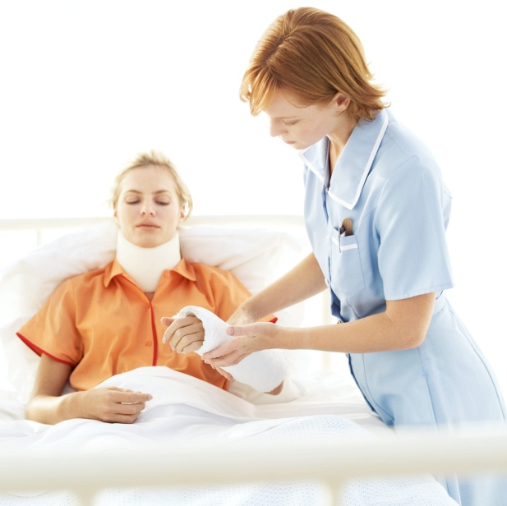
Theory of Nursing Systems
Nursing systems is a series of actions preformed by the nurse at the same time of the patient to help meet the patients self-care demands and encourage development of the patients’ self-care agency (Alligood, 2010, p. 271).

Slide 13

Self Care
In Orem’s theory of self care she identified three categories of self-care requisites (Current Nursing, 2010)
  Universal
  Developmental
  Health Deviation

Slide 14



Universal Self-Care Requisites
Universal self-care requisites are needs that are common to all human beings throughout all stages of the life cycle, and can be adjusted for age and environment. (Hartweg, 1991, p. 21).
  Air
  Water
  Food
  Elimination
  Activity/Rest
  Social Interaction
  Prevention of Hazards
  Promotion of Normalcy

Slide 15
Developmental Self-Care Requisites
Separated into two types:
  Maturational (related to the universal requisites).
    These can be adjusted for age or development because everyone has different needs or requirements. (Hartweg, 1991, p. 21).
  Situational
    These are life experiences that can impact human development.
      Examples of these would be a death in the family or moving. (Hartweg, p. 21).

Slide 16
Health Deviation
These deficits come from the needs produced by the illness (DeLane, Ladner, 2002, p. 34).
  Seeking and securing appropriate medical assistance
  Being aware of and attending to effects of pathological conditions
  Carrying out medically prescribed measure
  Modifying ones self-concept as being in a particular state of health
  Learning to live with medical condition

Slide 17
Metaparadigms
Person: an individual with physical and emotional requirements for development of self and maintenance of their well being.
Environment: Individuals surroundings which may affect their ability to perform their self care activities (George, 1995, p. 106-108).

Slide 18

Metaparadigms
Health: structural and functional soundness and wholeness of the individual.
Nursing: Acts as a specially trained and able individual to help a person or multiple people deal with their actual or potential self care deficits (George, 1995, p. 106-108).

Slide 19
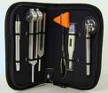
Framework for Patient Assessment
Orem’s model is ideal to use as a framework for patient assessment because it can be applied to any situation and addresses all areas of a patient’s well being.
The nurse must also collect data known as Basic Conditioning Factors.
  Age
  Gender
  Health State
  Developmental State
  Sociocultural orientation
  Health care system
  Family System
  Patterns of Living
  Environment
  Resources
These Factors influence the patients ability to perform self-care(Current Nursing, 2010) (Santrock, 2009, p. 22).
Notes:
Basic Conditioning Factors:
Age
Gender
Health State
Developmental State (Erikson’s developmental stages, examples: integrity vs. despair, generativity vs. stagnation)
Sociocultural orientation (race, ethnicity, level of education)
Health care system (hospital, long term care facility, home care)
Family System
Patterns of Living (does the pt live alone or with family)
Environment (housing, rural or city, do they have to climb stairs)
Resources (who can be support, such as a spouse, parent, sibling)

Slide 20
Methods of Helping
Using the self-care requisities the nurse identifies where the patient has a deficit and needs assistance.
According to Orem there are three different methods of helping.
  Wholly compensatory nursing system – The patient is unable to perform any self-care actions and the nurse must perform all of them.
  Partly compensatory nursing system – The patient can perform some, but not all, of their self-care actions.
  Supportive-educative nursing system – The patient can perform all self-care actions but needs education. (Hartweg, 1991, p. 27-29).

Slide 21
Case Study in a Clinical Practice
“The nurse’s role is to assist the client/patient with self-care practices and to maximize self-care abilities. Nursing is needed when the client/patient cannot continuously maintain the amount and quality of self-care” (Weir 1993)
Mr. James Smith came to the med surge unit from the emergency department. He was involved in a motor vehicle accident and has a broken humerus, 2 broken ribs and a punctured lung.

